Slide 1
www.interra.com.tr

Slide 2
RESIDENCE / SOLUTIONS
Project Name:
Concern:
Gülşah BALÇIN
İş Geliştirme Mühendisi
gulsah.balcin@interra.com.tr
www.interra.com.tr

Slide 3
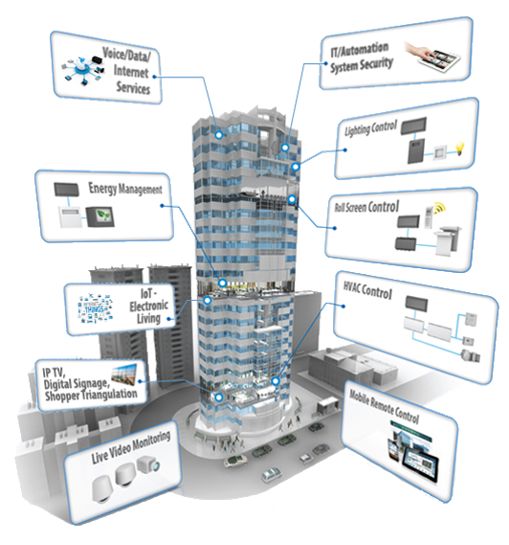
Developer of uniqueness
INTERRA RESIDENCE / VILLA SOLUTIONS
Automation Control
Consignment Services
Intercom
Security, Alarm
Camera Monitoring
Remote Control
Sample Project Review
Products

Slide 4
AUTMATION CONTROL
Scenarios
Lighting
Shutter-Blinds
Air conditioning

Slide 5
Scenarios
The comfort of performing multiple controls with a single touch
Goodbye, welcome, vacation, party, ready-made scenarios
Control of scenarios via mobile devices

Slide 6
Lighting
Control of illuminations via smart switch, touch panel or mobile devices
Lighting control with conventional switches using button interface
Light level setting (dimming control) to make
Providing lighting control and energy saving with presence detectors
Lighting is turned on when it is dark with lighting sensor, lighting is turned off when the weather illuminated
www.interra.com.tr

Slide 7
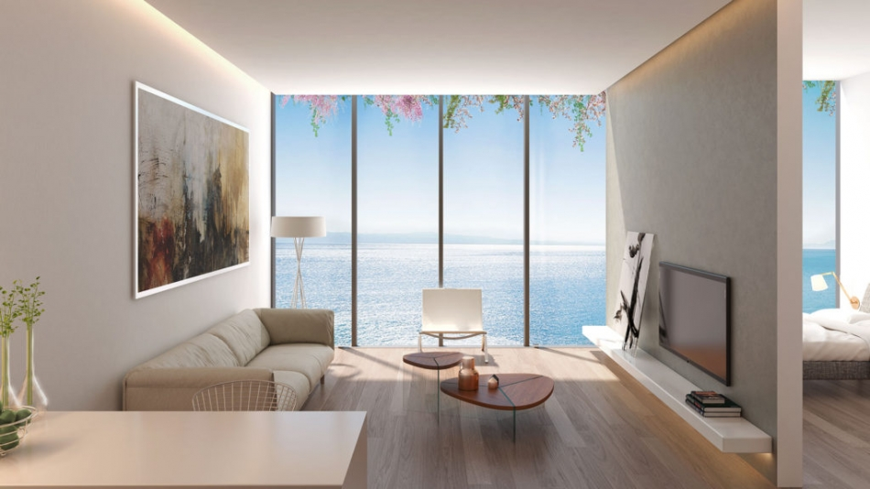
Shutter-Blinds
All types of curtains and blinds control (220 VAC, 24 VDC)
Control of shutter - blinds over time or scenarios
The position of the shutter blinds are automatically adjusted according to the light level detected by the light sensor
www.interra.com.tr

Slide 8
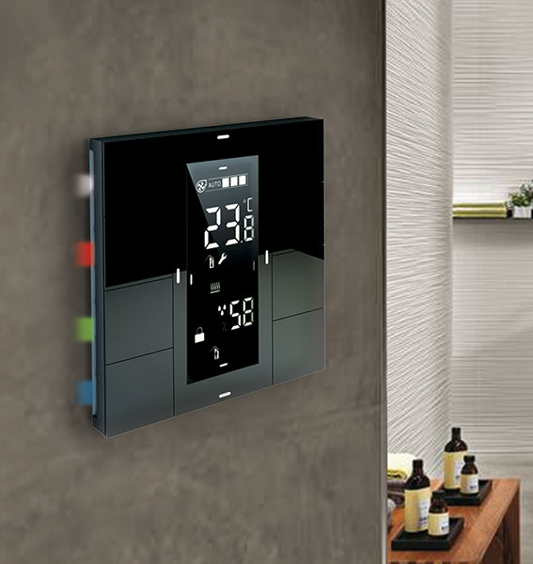
Air conditioning
Control of air conditioning, fan-coil, VRF systems
Control of the temperature of the site and increase the comfort with scenarios
Integration of air conditioning in building automation
Energy saving air conditioning structure
Air conditioning adjustment via thermostat, touch panel and mobile device
www.interra.com.tr
Notes:
VA: Bu sayfadan sonra bir sayfa eklenmeli ve konvan siyonel push buttonlar ile de otomasyon kontrolüne değinilmeli
2. Bir yeni sayfadan genel özellikler listelenebilir:
Asansörü kata çağırma
Subasma vb dedektörlerin panele direk bağlanması

Slide 9
Other Features of Automation Control
To be able to call the elevator via the panel with newly developed systems
Alarm sounding with information from the magnetic contact when the door is forced.
Switching off the water valves with the output information sent from the panel against the input from the water flood detector to the panel.
Alarm sound with motion detected from motion sensors.
www.interra.com.tr

Slide 10
Developer of uniqueness
Concierge Services
www.interra.com.tr

Slide 11
Developer of uniqueness
Concierge Services
Interra concierge solution services
5-star hotel comfort in residence life
Residence service platform providing individual or collective services
Cleaning, technical service, valet, taxi or residence service, hairdresser, massage, spa services through the panel or mobile device access and service
Services Management Cameras Invoices Announcement and
-Taxi -Message -Monitoring -Notification of Advertisement
-Carwash -Information page dues and -Sending of dynamic
-Cleaning invoices message,Picture and
-Petting video
-etc…
www.interra.com.tr

Slide 12
Developer of uniqueness
Concierge Services
Interra Concierge Solution Benefits
A rational approach to the problem of communication within the building and the compound
Maximum comfort and privileged lifestyle for apartment residents
To adds value to the project and life
www.interra.com.tr

Slide 13
Developer of uniqueness
Concierge Services
Interra Concierge use of
Use from smart phones and tablets as well as INTERRA Touch Panels
Receiving of messages and notifications from all devices
www.interra.com.tr

Slide 14
Developer of uniqueness
Concierge Services
Interra concierge solutions application areas
Simple structure, Interra is server with industrial design and touch panel
Training and technical support for residential, building management
It does not require a special structure, working through the network system, single structure for concierge solution, intercom, etc.
www.interra.com.tr

Slide 15
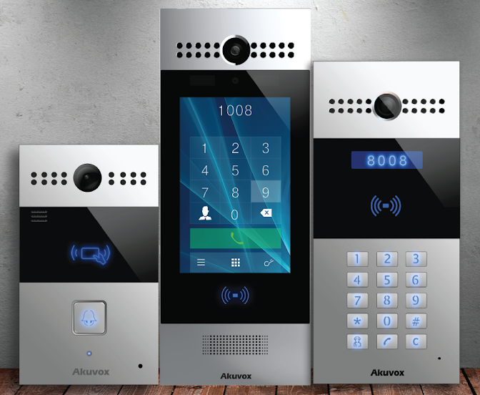
INTERCOM
IP-based telephone and video intercom in front of the building, you can meet the guests at your door, you can contact if you wish.
With the SIP phone and IP Camera, both the security can be spoken and the incoming contact can be seen through the panel.
Voip and sip dialing can be done with the buzzer panel, both voice calls can be made over IP and calls can be made via the central station.

Slide 16
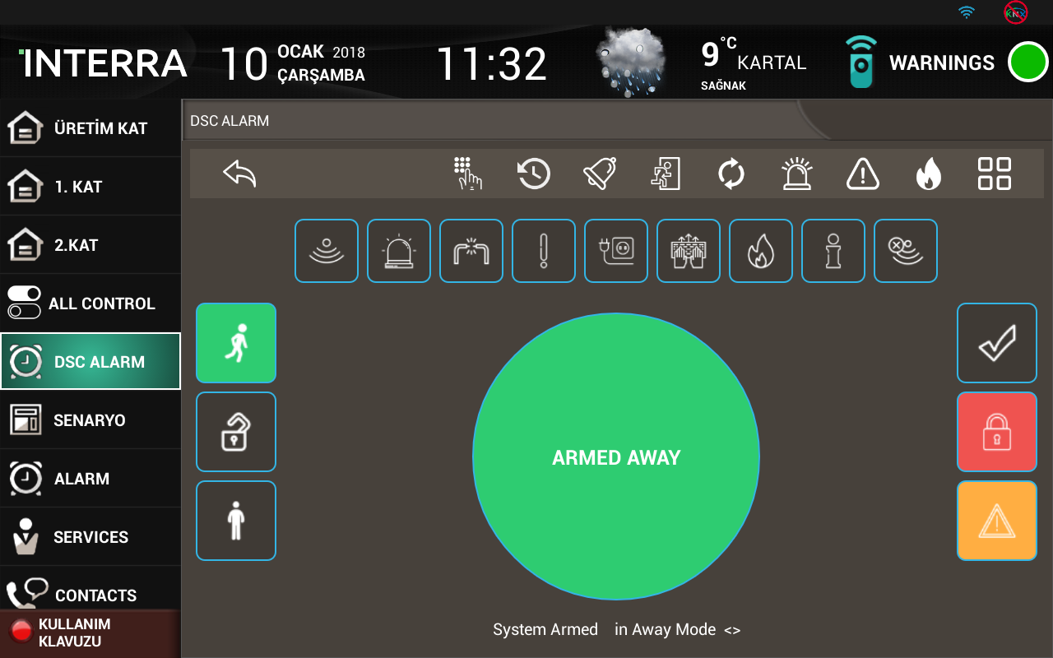
SECURITY AND ALARM MONITORING
IP or analog camera control system
Installation and monitoring of apartment and site based security system
Announcement of security alarm scenarios related to IP integration
Fire system
Alarm system
Access control system
Full Integration DSC Security System

Slide 17
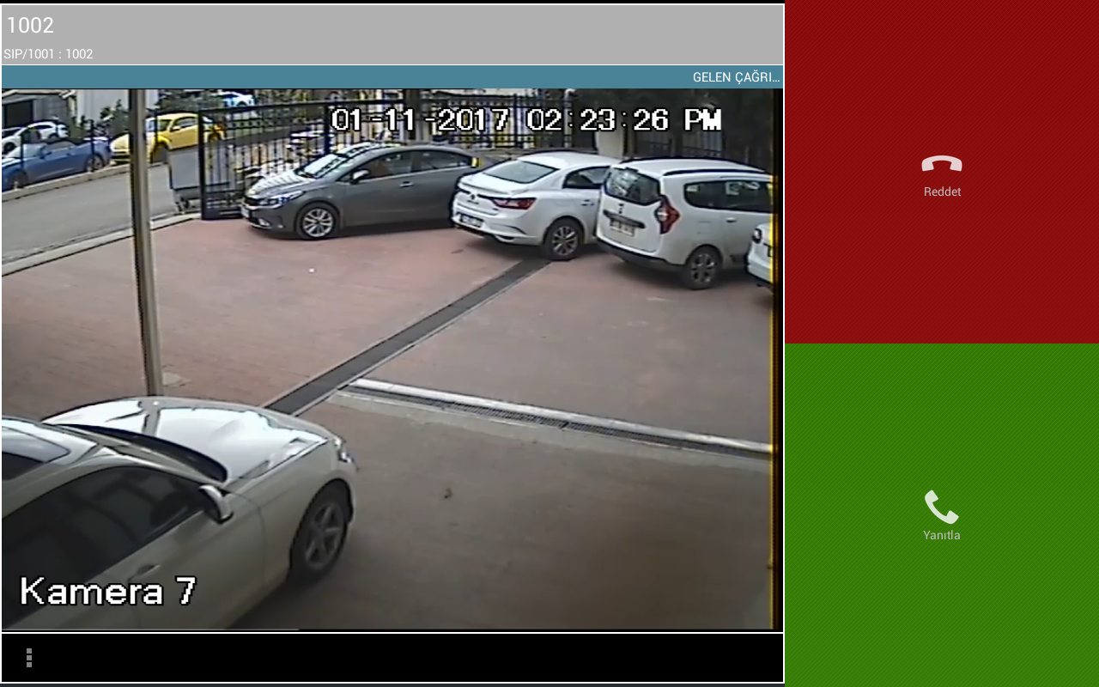
Developer of uniqueness
CAMERA MONITORING
View all cameras over the panel
Communication systems;
CCTV Monitoring
Doors and Gates
Reception

Slide 18
Developer of uniqueness
INTERRA REMOTE CONTROL
Access to all functions of home comfort via mobile devices
Flexibility in many services such as road condition, money markets
Control of smart homes from tablets or mobile phones with Android and IOS support

Slide 19
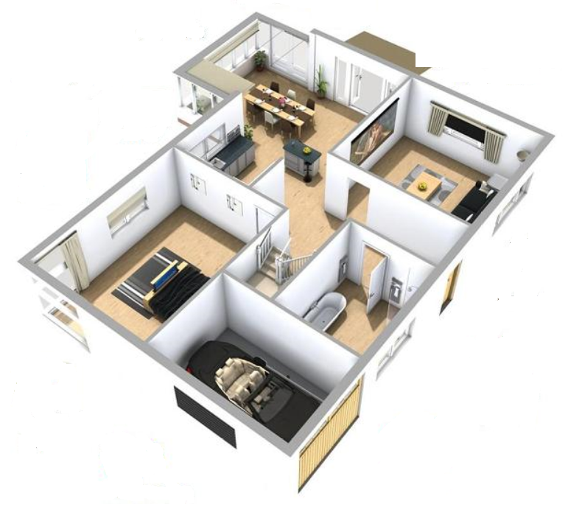
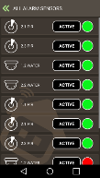
TOUCH PANEL
SECURITY
INTERCOM
LIGHTING
HEATING
COOLING
CAMERA
SHUTTER BLINDS
REMOTE CONTROL

Slide 20
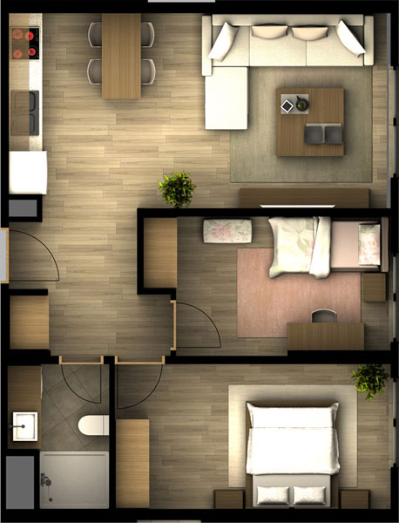
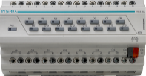
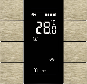
Residence Solutions (KNX Based Solution)
KNX – YCYM 2x2x0.8mm2
KNX Functionality
KNX Devices
KNX Touch Panels
Mobile application
Contact
Services
KNX
KNX
TCP/IP
SITE MANAGEMENT
Ip Telefon
Concierge Server
SIP Server
www.interra.com.tr

Slide 22
Developer of uniqueness
Villa Project Design

Slide 23
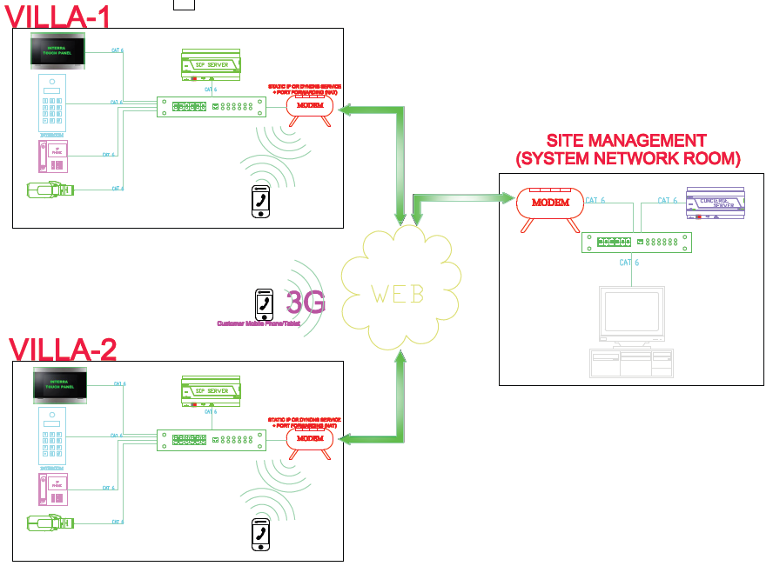
Developer of uniqueness

Slide 24
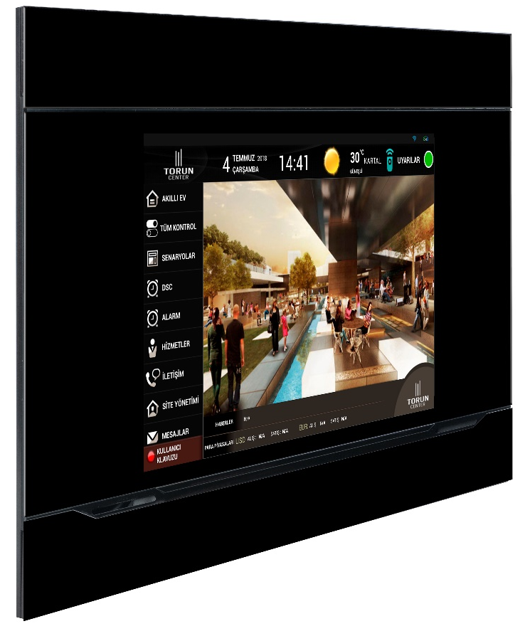
Developer of uniqueness
INTERRA TOUCH PANEL
You can easily control video intercom, lights, heating system, blinds and alarm system with the help of a single control screen.
10" Touch Panel
7" Touch Panel
www.interra.com.tr

Slide 25
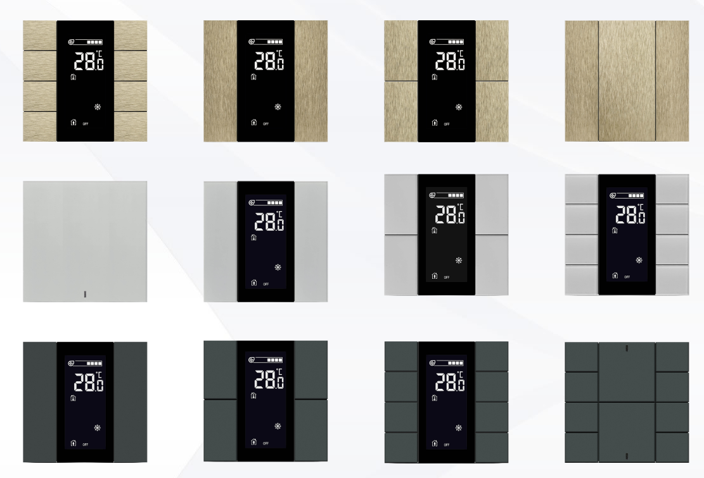
Developer of uniqueness
INTERRA ISWITCH
Integrated temperature, humidity and brightness sensors automatically control the fields.
The energy consumed by the KNX BUS line consumes very little energy.
Oda Kontrolleri
Aydınlatma
Panjur
HVAC
Termostat
www.interra.com.tr

Slide 26
Developer of uniqueness
KNX POWER SUPPLY
KNX power supplies generate voltage for the KNX system. (SELF) The KNX line is separated from the power supply by means of an insulated coil. The voltage output is protected against short circuit and overload. Indicates the device output status with two-color LED. It has an external 30VDC output.
Power Supply, 160 mA
Power Supply, 320 mA
Power Supply, 640 mA
www.interra.com.tr

Slide 27
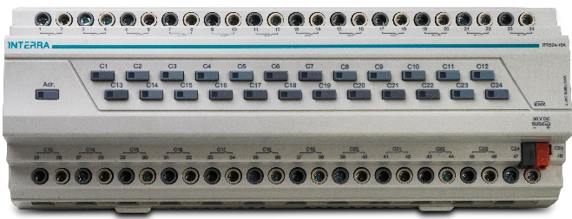
Developer of uniqueness
INTERRA KNX COMBO
You can do all the controls with a single combo;
Lighting
Shutter Blinds
FCU
6 different sizes between 4 and 24 channels 4,8,12,16,20,24 channel combos provides you project efficiency.
www.interra.com.tr

Slide 28
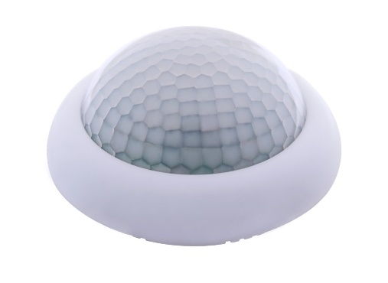
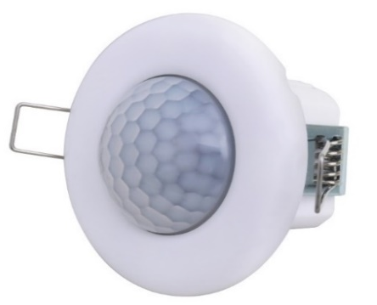
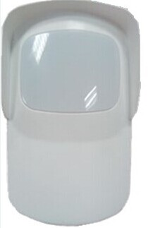
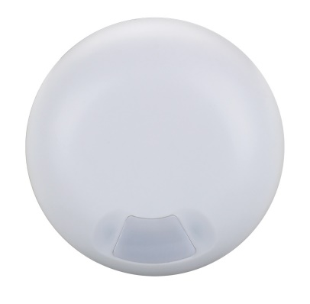
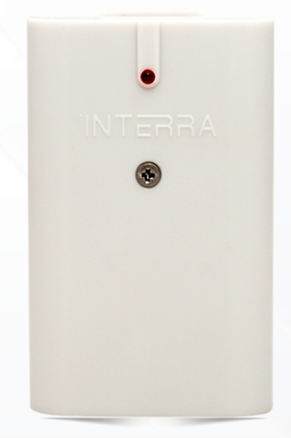
Developer of uniqueness
KNX Motion Sensor 24m / 8m
SENSORS
KNX sensors provide high energy efficiency.
KNX Sensors can trigger scenarios.
Sensors can trigger an alarm.
KNX LUX Sensor
KNX Microwave Sensor
Water Flood Detector

Slide 29
Developer of uniqueness
INTERRA DIM MODULE
ITR500-002, 4 channels each channel has 1.5A capacity dimming.
Leading Edge or Trailing Edge can be used for dimming.
ITR500-001, Each channel can dimming over ballast with 0-10V method.
For each channel there are 10A current carrying value relays and can also be controlled manually.
www.interra.com.tr

Slide 30
Developer of uniqueness
MITSUBISHI ELECTRIC KNX GATEWAY
Mitsubishi Electric provides full integration of air conditioning with KNX bus.
Mitsubishi Electric provides full two-way integration (control and monitoring) between the air conditioning indoor unit and KNX.
Provides 3 different digital inputs (eg Motion detector, drain pump, push button) to integrate into KNX.
www.interra.com.tr

Slide 31
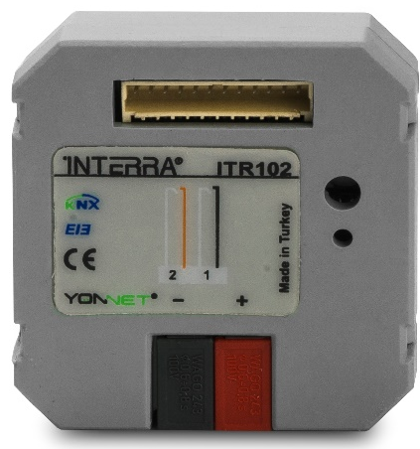
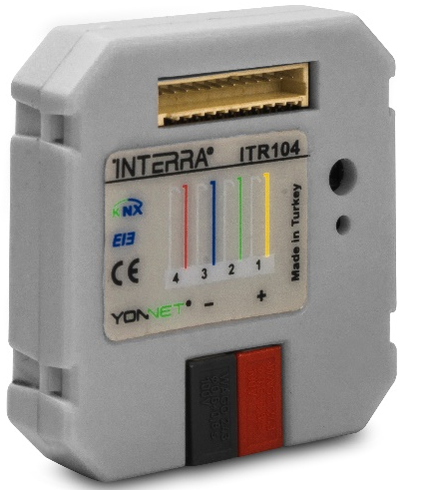
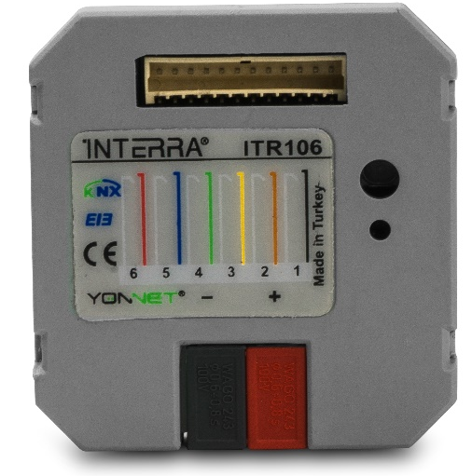
Developer of uniqueness
INTERRA PUSH BUTTON
It is capable of converting the contact signal to any KNX signal.
2-gang (channel)
4-gang (channel)
6-gang (channel)
The input module is placed in the standard electrical box of the switch or socket. And it helps provide KNX controls over traditional switches.
www.interra.com.tr

Slide 32
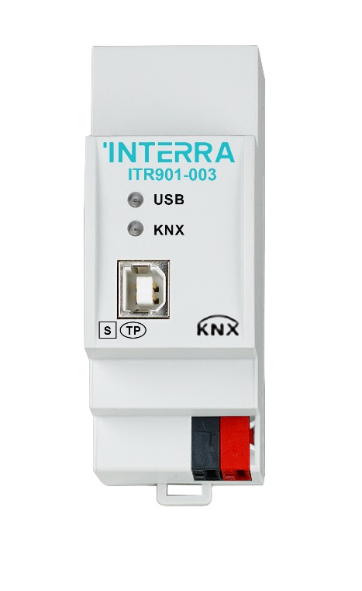
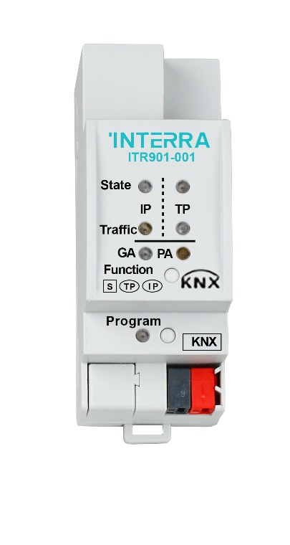
Developer of uniqueness
INTERRA SYSTEM COMPONENTS
KNX IP ROUTER
KNX LINE COUPLER
KNX USB INTERFACE
www.interra.com.tr

Slide 33
Developer of uniqueness
INTERRA RESIDENCE / VILLA SOLUTIONS

